Slide 1
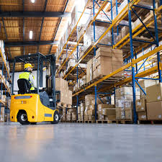
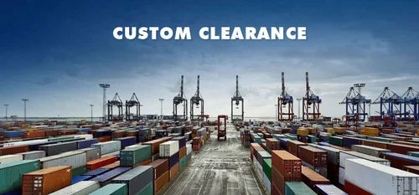
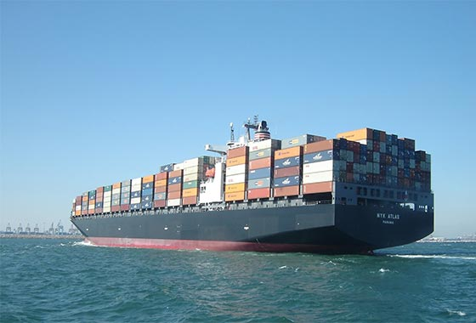
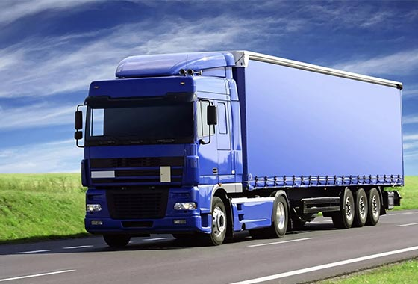

WELCOME TO ARTIMAX LOGISTICS llp (ATL)

Slide 2
ARTIMAX LOGISTICS llp (ATL)
ABOUT US
ARTIMAX LOGISTICS LLP (ATL) is an international logistics provider and integrator offering the full gamut of Logistic Solutions. We are known for our expertise in international freight forwarding, warehousing, distribution and in customs clearance.
A network of our agents has been established throughout our operational area to ensure reliable and cost-efficient logistic solutions.
We have built-up a large Agent-base globally, thus enhancing the Company’s ability to co-ordinate shipments from / to any corner of the globe.

Slide 3
ARTIMAX LOGISTICS llp (ATL)
VISION
To be the most reliable and efficient Transport and Distribution Service provider offering a broad spectrum of related services and products, committed to service excellence and renowned for our integrity and ability to deliver.
MISSION
To deliver value to customers by providing them with reliable & efficient services in Logistics. Earn Customers’ loyalty by thru consistent service offerings, innovative solutions and special services as and when needed. Develop long term partnership with clients and vendors. To make our customer’s supply chain more efficient by offering integrated & customized logistics solutions with the help of world class technology and optimization of resources.

Slide 4

ARTIMAX LOGISTICS llp (ATL)
SERVICES
AIR FREIGHT .
ARTIMAX LOGISTICS LLP has established and sustained its industry leadership position in air freight logistics. This achievement has been possible due to the dedicated infrastructure, committed workforce, and a robust nationwide logistics network.
A regular shipment or small or critical air freight challenge, ARTIMAX LOGISTICS LLP can deliver results every time all the time. Our presence at every major gateway and airport in India enables us to move air freight cargo both efficiently and professionally.
We connect all the major global markets with focus on transit efficiency and limiting costs. Air freight shipments are scheduled by determining the most effective and efficient routing, which ensures service delivery both on time and cost.
Our Air Freight Services include:
▪ Hazardous Cargo
▪ Precious Metal Cargo
▪ Fashion & Luxury Goods
▪ Auto and Automotive part
▪ Furniture product
▪AOG & Aerospace Cargo
▪ Pharmaceutical Cargo

Slide 5
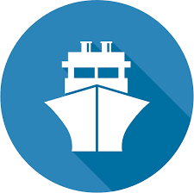
ARTIMAX LOGISTICS llp (ATL)
OCEAN FRIEGHT .
Ocean Freight is one of the key elements in multimodal transportation service. In order to offer the best service possible, we have a dedicated Ocean Freight Department specializing in FCL, LCL, Break-Bulk, Project Cargo and different types of cargoes on a global scale. The flexibility and range of Ocean Freight Services offered by ARTIMAX LOGISTICS LLP provides our customer economical alternatives to other, more costly modes of transportation. Our worldwide logistics services cover not only shipments from port-to-port, but also the complete door-to-door supply chain solution. Over the years, ARTIMAX LOGISTICS LLP has fostered strong business relationship with all major international and regional ocean carriers.

Slide 6
ARTIMAX LOGISTICS llp (ATL)
Our Sea Freight Services include:
▪ FCL and LCL import and export
▪ Issuance and verification of shipping documentation
▪ Export and import customs clearance
▪ Certified industrial packing and crating
▪ Warehousing, assembly and distribution logistics
▪ Conventional shipments (break-bulk, dry )
▪ Sea/Air transportation
▪ Sea/Road and Sea/Rail Intermodal Services
▪ Transport and Marine Insurance

Slide 7


ARTIMAX LOGISTICS llp (ATL)
ROAD FREIGHT WAREHOUSING
Our Road Freight Services :
▪ Assembly and Synchronous Positioning of Load Units (JIT)
▪ Transportation of LTL, FTL and Bulk Cargo
▪ Tracing & tracking through the Global Positioning System
▪ Various value added services
▪ Customs bonded transportation
Our Warehousing Services include:
▪ Short and long term storage
▪ Cargo loading and unloading
▪ Cargo labelling and packing
▪ Fumigation and Pest control
▪ Packing and Crating services
▪ Cargo Distribution
▪ POD Reporting

Slide 8
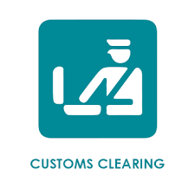
ARTIMAX LOGISTICS llp (ATL)
customs clearance .
Our Customs Services :
▪ Import / Export Customs Clearance Service ▪ Customs Evaluation of merchandise
▪ Import Duty & Tax Assessment
▪ Import/Export Permissions of controlled goods
▪ Import / Export Record maintenance
▪ Payment of Custom Duties on customers behalf
▪ Permanent Import/Export procedures
▪ Consultancy Services
▪ Customs Bonded Carriage
▪ Transit Customs Handling
Our team is able to deal with all types of customs clearance at ports of entry and exit. We take care of all relevant documentation, customs examination, facilitate payments of duty and arrange delivery once the cargo has been cleared.

Slide 9



ARTIMAX LOGISTICS llp (ATL)
Contact us to serve you best.
+91 9819195243
+91 9987301201
info@artimaxlogistics.com
B-506, RAYLON ARCADE, KONDIVITA LANE, JB NAGAR,
ANDHERI EAST 400059
THANK YOU

